Slide 1
Introduction to Cryptography
Cryptography Day 1

Slide 2
Today’s Objectives
By the end of class, you will be able to:
Articulate the goals of cryptography.
Discuss modern encryption standard, particularly AES.
Differentiate between substitution and transposition ciphers.
Explain how textual data can be represented in binary, octal, and hex.
Determine the output of the XOR operation given two input bitstreams.
Compare and contrast symmetric and asymmetric cryptography
Use OpenSSL to encrypt data with a symmetric key.

Slide 3
Introduction to Cryptography

Slide 4
Why Cryptography Matters
Threat Actors
Sender
Receiver
Secure Channel with Data Exchange
Information is often the most prized asset of individuals and organizations.
Ensuring information can be stored, transmitted, and received securely is a central responsibility of modern security professionals.
Notes:
Image Recreated

Slide 5
Goals of Cryptography
Introducing the P.A.I.N Framework:
Privacy
Authentication
Integrity
Non-repudiation

Slide 6
Goals of Cryptography
We’ll look at each of these pillars in more detail later, but here is a brief overview of how each goal protects data:
Privacy ensures it is accessible by the intended recipients.
Authentication ensures it is sent from the claimed sender.
Integrity ensures it can’t be intercepted and modified in flight.
Non-repudiation verifies if an individual did or did not send data.
Notes:
Cryptography concerns itself with protecting our privacy— and in particular, it gives us a way to guarantee that messages:
Can be read only by intended recipients, ensuring Privacy/Confidentiality
Do, in fact, come from the claimed sender(s), ensuring Authenticity
Can't be intercepted and modified in flight, ensuring Integrity
Can't be repudiated. In other words, we can verify whether an individual did or did not send a message, ensuring Non-Repudiation

Slide 7
Goals of Cryptography
Each pillar is supported by specific methods and tools.
Privacy is provided through encryption.
Authentication is provided through digital signatures.
Integrity is checked through hashes.
Non-repudiation is supported through signatures and certifications.

Slide 8
Student Activity:
Key Terms and Orientation
In this activity, you will familiarize themselves with some key terms in cryptography.
15 Minutes

Slide 9
Key Terms and Orientation
Instructions:
1. Use the Cryptography Terminology resource and Wikipedia to define and provide an examples for each of the following terms:
Privacy
Authenticity
Integrity
Non-Repudiation
2. Define the following key terms, and provide an example of each if you can:
Plaintext Ciphertext Cryptography Code Bit Cipher Encryption
Key Encryption Decryption Symmetric-Key Cryptography Asymmetric-Key Cryptography
Hash Signature Checksum

Slide 10
Key Terms and Orientation

Slide 11
Modern Cryptosystems and Standards

Slide 12



Modern Cryptosystems and Standards
Encryption, Decryption and Keys
Encryption is the process of obfuscating a plaintext by converting it into ciphertext by using a special values called a key along with a fixed set of rules.
Decryption is the process of turning a ciphertext back into plaintext.
The key must remain SECRET! Once the key is known, you can easily decrypt messages by applying the rules in reverse.
Notes:
Some encryption methods are "stronger" than others.
In other words: "Strong" encryption is encryption that is hard to reverse without the key. "Weak" encryption is that which is easy to reverse without the key.
Decrypting without a key is called cracking or breaking encryption.
Encryption gets stronger as the rules for transforming the plaintext get more complicated. This implies strong encryption, by definition, must be complicated.

Slide 13
Encryption and decryption must be complex enough to provide a strong security but also simple enough to perform quickly with the key.
The Cryptography Trade-off

Slide 14
Ensuring Privacy and Confidentiality
Data at Rest
Data in Motion
Static data, such as that stored on a hard disk or a database.
Prevents it from being intelligible to prying eyes
Data moving between machines on the network, such as your computer and YouTube, or your phone and the cell tower.
More complicated than protecting data at rest
Notes:
Compliance with industry standards often requires properly encrypting both Data at Rest and Data in Motion, so striking a balance between strength and speed is an important business consideration.
The goal of protecting Data at Rest is to prevent it from being intelligible to prying eyes, in the event that the data is exposed unintentionally.
For example, if someone steals your laptop, but it has an encrypted disk, they can't read the data, even though they have all of it.
Storing sensitive data in multiple locations, to ensure that compromise of one location doesn't expose the entire data set.

Slide 15
Ensuring Privacy and Confidentiality
Data at Rest
Data in Motion
Protected by encrypting data on hard drives and in databases and storing sensitive data in multiple separate locations.
Tools:
Using AES to encrypt data
Storing AES-encrypted data in multiple database.
More complicated, as at least two machines are exposed to the data.
Must be able to encrypt / decrypt quickly
Tools:
Using AES in combination with RSA to protect communications on the web with TLS
Using SSH to encrypt remote shell sessions
Notes:
Protecting data in motion is more complicated.

Slide 16

Notes:
2009

Slide 17



Ensuring Authenticity
With authenticity, a user can verify the identity of a data source.
Attackers can send encrypted data claiming to be someone they’re not
Encryption will provide little protection in these cases.
With the use of asymmetric cryptography, digital signatures are the main tool used to verify the authenticity of a message. Then, we can ensure:
Emails came from the claimed sender.
Downloaded files come from the correct server.

Slide 18

Ensuring Integrity
We need to know that the data we are sharing is the correct information.
Hashing can be used to verify the integrity of data by:
Verifying that a file downloaded from a server is in fact the file on the
server, as opposed to an attacker intercepting and modifying the file.
Verifying that data has made it across the wire without corruption.
Client requests data from a server
Server sends the hash digest of data to the client
Server sends the requested data
Server hashes data received and compares to digest from server
If digest matches, the data hasn’t been corrupted

Slide 19



Ensuring Non-Repudiation
Ensuring that a message is inextricably linked to a sender.
If Bob sent a nasty memo to an entire department, non-repudiation ensures that he can’t scapegoat someone else.

Slide 20
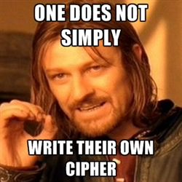
Notes:
Even for those with this advanced knowledge, cryptography is tricky.
Even experts make mistakes, and as computers get faster, methods that were previously "complicated" become easy to break.
Cryptographers hedge against this risk by working together to develop and test cryptographic methods.

Slide 21
Today’s de facto standard of symmetric key algorithm is AES.
Developed through community collaboration led by the National Institute of Standards and Technology.

Slide 22
Activity: DES Death March
In this activity, you will research the NIST competition model then answering the corresponding questions.
Instructions sent via Slack
15 Minutes

Slide 23
DES Death March

Slide 24
Checkpoint:
By the end of class, you will be able to:
Articulate the goals of cryptography.
Discuss modern encryption standard, particularly AES.
Differentiate between substitution and transposition ciphers.
Explain how textual data can be represented in binary, octal, and hex.
Determine the output of the XOR operation given two input bitstreams.
Compare and contrast symmetric and asymmetric cryptography
Use OpenSSL to encrypt data with a symmetric key.

Slide 25

The Key Concept of Cryptography
Plaintext
Ciphertext
Encryption
Readable Message, File or Data
Encrypted Message, File or Data
Key(s)
Decryption
A key the piece of information / parameter that specifies
how plaintext should be transformed into ciphertext
and vice versa.
Notes:
Before diving in, let students know that a thorough understanding of these details is not required for most jobs.
Emphasize that this is important context for understanding cryptography in practice, but that mastery of these mechanisms is not required for day-to-day work in security.
the most basic goal of cryptography is to protect the confidentiality of important data, which occurs through encryption.

Slide 26
Do we want an incredibly strong cipher that’s hard to compute and difficult to decrypt?
OR
Do we prefer an average cipher that is faster.
The Cryptography Trade-off
Notes:
This set of rules is reversible, through a process called decryption, and is why we can recover the original, meaningful message from the encrypted, meaningless mess. This is also the reason that encrypted messages are vulnerable to attack. Since an intended recipient can "undo" encryption with the right tools, attackers can, in principle, do so as well.

Slide 27
Ciphers and Keys
Notes:
We'll investigate this tradeoff by examining classical ciphers, which got stronger over time, and provide the conceptual basis for modern methods that are both strong and efficient.

Slide 28
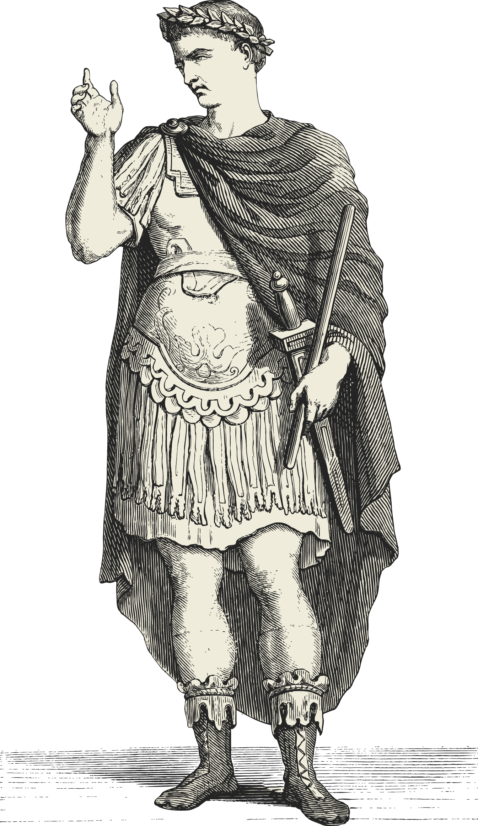
The Ceasar Cipher
They Shall Never Crack My Code!
One of the best known historic encryption techniques/
A simple substitution cipher in which a message is shifted a number of letters down the alphabet according to a key.
Sender:
Writes a Message
Selects a Key
Encodes Message
Recipient:
Receives Message
Uses known Key
Decodes Message

Slide 29
How the Caesar Cipher Works
Original
Key = 2
A
B
C
D
E
F
G
H
I
J
A
B
C
D
E
F
G
H
I
J
Encoded
The Caesar Cipher works by shifting letters a set number (key value) of indices from the original position.
Example for Key = 2:
“I HID A CAB” → “K JKF C ECD”
“A BAD DAD” → “C DCF FCF”
Notes:
Diagram recreated

Slide 30
Transposition Ciphers
Transposition Ciphers are permutations that break messages into equal sized blocks and re-arrange the letters to a fixed rule.
Permutation is simply a rearrangement of a sequence of letters.
hlleo is a permutation of hello
The following rule breaks an input into three blocks and replaces the 1st, 2nd, and 3rd letters of the block with the 3rd, 1st, and 2nd respectively.
|1 2 3|
E = | |
|3 1 2|

Slide 31
Transposition Cipher
| 1 2 3 |
E = | |
| 3 1 2 |
H e l l o !
1 2 3 1 2 3
Becomes =

Slide 32
Transposition Cipher
| 1 2 3 |
E = | |
| 3 1 2 |
H e l l o !
1 2 3 1 2 3
Becomes = l

Slide 33
Transposition Cipher
| 1 2 3 |
E = | |
| 3 1 2 |
H e l l o !
1 2 3 1 2 3
Becomes = lh

Slide 34
Transposition Cipher
| 1 2 3 |
E = | |
| 3 1 2 |
H e l l o !
1 2 3 1 2 3
Becomes = lhe

Slide 35
Transposition Cipher
| 1 2 3 |
E = | |
| 3 1 2 |
H e l l o !
1 2 3 1 2 3
Becomes = lhe!

Slide 36
Transposition Cipher
| 1 2 3 |
E = | |
| 3 1 2 |
H e l l o !
1 2 3 1 2 3
Becomes = lhe!l

Slide 37
Transposition Cipher
| 1 2 3 |
E = | |
| 3 1 2 |
H e l l o !
1 2 3 1 2 3
Becomes = lhe!lo

Slide 38
Activity: Simple Ciphers and Key Spaces
In this activity, you will practice using each of the classical ciphers discussed in the lecture.
Instructions sent via Slack.
13 Minutes

Slide 39
Cipher and Key Spaces

Slide 40
Character Encoding
and
Binary Representation

Slide 41
Letter ciphers are not compatible with the numerical representation of digital data.
Notes:
Letter ciphers were viable in the past, but they are incompatible with the numerical representations of digital data.

Slide 42

Encoding
?
Once upon
a time….

Slide 43

Encoding
?
Once upon
a time….
Notes:
Trouble is, how do you represent characters using numbers? The solution is mapping: the processing of assigning an element of a set to another

Slide 44

Encoding
?
82 23 23 65 09 29 24
25 19 65 89 38 08 11
29 84 55 01 95 32 15
Once upon
a time….
Notes:
One could do it in an infinite number of ways. You could assign each letter, digit, and symbol to a number. You could decide to assign only the common letters, digit, and symbol to numbers and leave out the others.

Slide 45
Character Encoding is the process of representing letters as numbers in order to encrypt data on computers.

Slide 46
Character Encoding
Some forms of character encoding we’ll look at: ASCII
ASCII stands for the American Standard Code for Information Interchange.
It is used to represent computer-stored characters in a human-readable format.
Look down at you keyboards. Every character is part of ASCII system: Upper and lowercase letters, special characters (!@#$...), numericals (1,2,3,4…)
We can convert strings of comprehendable sentences into purely numerical strings.
Check out ASCII Table Chart

Slide 47
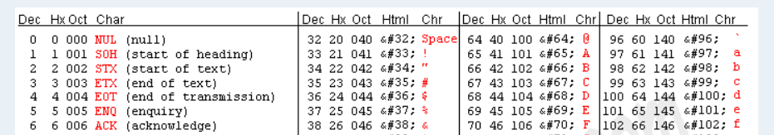
ASCII Encoding
Go to: http://www.asciitable.com/
Notes:
ASCII, UNICODE, EBCDIC, etc., are products of such mappings. Each of them are different and useful in there own way. For example, ASCII requires less bytes and is simpler than UNICODE while UNICODE gives you more characters.
The most basic form of character encoding we'll discuss is ASCII Encoding.
The ASCII Encoding represents every letter of the English alphabet, as well as common punctuation marks, as a number between 0 and 128.
Note that ASCII Encoding is similiar to a substitution cipher!

Slide 48
ASCII Encoding
Dec
Chr
Chr Dec Hex Oct
A = 65 = 41 = 101
a = 97 = 61 = 141
Notes:
by reading the Chr (Character) and Dec (Decimal) columns, this table allows you to map, e.g., capital A to 65; lowercase a to 97; etc.
So now we know how to convert letters into numbers.
but what does a computer need to be able to function at the hardware level?

Slide 49
Character Encoding
Some forms of character encoding we’ll look at: Binary
Binary Number System is the numerical representation of computer data as 1’s and 0s
A is 65 in ASCII, but 65 is not intelligible to a CPU, so we change A to 65 and then 65 into 1s and 0s.
We can understand Binary if we examine it relative to the common decimal system:
Binary counts in 2s (2 base value) whereas Decimal counts in 10s (10 base value).
2³ | 2² | 2¹ | 2⁰
8 | 4 | 2 | 1

Slide 50
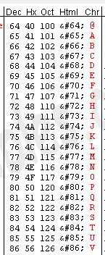
Binary
Dec = 72
Dec = 72

Slide 51
Binary
Dec = 72
Dec = 72 01001000

Slide 52
Binary
Dec = 72
Dec = 72 01001000
128 64 32 16 8 4 2 1
0 0 0 0 0 0 0 0

Slide 53
Binary
72
-64
8
128 64 32 16 8 4 2 1
0 1 0 0 0 0 0 0

Slide 54
Binary
72
-64
8
-8
128 64 32 16 8 4 2 1
0 1 0 0 1 0 0 0

Slide 55
Binary
hello =
01101000 01100101 01101100 01101100 01101111
Notes:
binary representation has the disadvantage of resulting in long numbers
Other number systems exist in part to allow for more compact representations of binary data, for which hexadecimal is particularly efficient.

Slide 56
Is there a better way to compact data?
HEXADECIMAL!

Slide 57
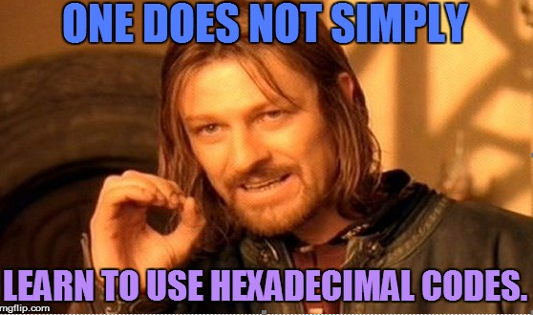
Hexadecimal
1, 2, 3 = Base 10
Binary = Base 2
Hexadecimal = Base 16

Slide 58


Slide 59
Hexadecimal and Octal
Even though computers read in binary, it is not a very efficient representation of data
Hello in binary = 11010001100101110110011011001101111
Hexadecimal system is a more compact representation of binary data.
Hex uses 16 characters to represent the base value. In other words, it is a base 16 system
The base numbers range from 0-9 and then letters A-F represent 10, 11, etc.
(A = 10, B= 11, C =12...F=15. etc.)
If we count our fingers using the decimal system, we’d count 1 to 10.
If we count on our fingers using the hex system, we’d count 1 to A.
Hexadecimal numbers are written with a \x to indicate the following number is to be read as hex: \x10

Slide 60
Hexadecimal
How do you represent 16 numbers using only a single digit?
0-9
A
B
C
D
E
F

Slide 61
Hexadecimal
How do you represent 16 numbers using only a single digit?
0-9
A
B
C
D
E
F
16³ | 16² | 16¹ | 16⁰

Slide 62
Hexadecimal
How do you represent 16 numbers using only a single digit?
0-9
A
B
C
D
E
F
B | A | 5 | 5
16³ | 16² | 16¹ | 16⁰

Slide 63
Hexadecimal
How do you represent 16 numbers using only a single digit?
0-9
A
B
C
D
E
F
B | A | 5 | 5
16³ | 16² | 16¹ | 16⁰
4096 | 256 | 16 | 1

Slide 64
Hexadecimal
How do you represent 16 numbers using only a single digit?
0-9
A
B
C
D
E
F
B | A | 5 | 5
16³ | 16² | 16¹ | 16⁰
4096 | 256 | 16 | 1
11

Slide 65
Hexadecimal
How do you represent 16 numbers using only a single digit?
0-9
A
B
C
D
E
F
B | A | 5 | 5
16³ | 16² | 16¹ | 16⁰
4096 | 256 | 16 | 1
11 * 4096

Slide 66
Hexadecimal
How do you represent 16 numbers using only a single digit?
0-9
A
B
C
D
E
F
B | A | 5 | 5
16³ | 16² | 16¹ | 16⁰
4096 | 256 | 16 | 1
45056

Slide 67
Hexadecimal
How do you represent 16 numbers using only a single digit?
0-9
A
B
C
D
E
F
B | A | 5 | 5
16³ | 16² | 16¹ | 16⁰
4096 | 256 | 16 | 1
45056 | 10 * 256

Slide 68
Hexadecimal
How do you represent 16 numbers using only a single digit?
0-9
A
B
C
D
E
F
B | A | 5 | 5
16³ | 16² | 16¹ | 16⁰
4096 | 256 | 16 | 1
45056 | 2560 | 5 * 16

Slide 69
Hexadecimal
How do you represent 16 numbers using only a single digit?
0-9
A
B
C
D
E
F
B | A | 5 | 5
16³ | 16² | 16¹ | 16⁰
4096 | 256 | 16 | 1
45056 | 2560 | 96 | 5
BA55 = 45,056 + 2560 + 96 + 5

Slide 70
Hexadecimal
How do you represent 16 numbers using only a single digit?
0-9
A
B
C
D
E
F
B | A | 5 | 5
16³ | 16² | 16¹ | 16⁰
4096 | 256 | 16 | 1
45056 | 2560 | 96 | 5
BA55 = 47,701

Slide 71
Hexadecimal
How do you represent 16 numbers using only a single digit?
BA55 = 47,701
47,701 in Binary =
1011101001010101
Notes:
The intuition for translating hex and octal to decimal is not important—the takeaway is that there are multiple ways to represent the same data, each of which is relevant in different circumstances.

Slide 72
The mechanics of conversion are not as important as simply knowing these systems are in place to represent and encode data.

Slide 73
Activity: Character-Encoding Scavenger Hunt
In this activity, you will complete a scavenger hunt by identifying the type of character encoding of the provided numbers, and then decoding it to find the next clue
Instructions sent via Slack
5 Minutes

Slide 74
Your Turn: Scavenger Hunt
Instructions
Convert the following into binary code:
57 65 6c 63 6f 6d 65 20 74 6f 20 74 68 65 20 73 63 61 76 65 6e 67 65 72 20 68 75 6e 74 21 20 47 6f 20 74 6f 20 74 68 65 20 66 6f 6c 6c 6f 77 69 6e 67 20 77 65 62 73 69 74 65 3a 0a 68 74 74 70 3a 2f 2f 77 77 77 2e 70 61 67 65 6f 72 61 6d 61 2e 63 6f 6d 2f 3f 70 3d 73 65 63 72 65 74 34
Hint: Copy and paste the above into Google and this should give you a list of results that will convert this code for you

Slide 75
Scavenger Hunt

Slide 77
Symmetric vs. Asymmetric
Cryptography

Slide 78

Symmetric-Key Algorithm
Symmetric-key algorithms are algorithms that use the same key to encrypt and decrypt.
Same Key
A$4h*L@9.7o71PLY202!bA)(!#&2910Go$@94^0#@
Encryption
Decryption
Plain Text
Plain Text
Cipher Text
Notes:
Recreated Diagram

Slide 79
Symmetric Encryption
The process:
Divide Data into Blocks (Transposition)
Perform a substitution on each block
Perform a permutation of the resulting substitution
The Key is XORed with the result permutation.
The process is repeated multiple times, and the blocks recombines create and encrypted whole.

Slide 80
Key Exchange
One key is required for each pair of people who want to share encrypted messages:
Alice, Bob, Eve, and Jane
Alice ⟷ Bob
Alice ⟷ Eve
Alice ⟷ Jane
Bob ⟷ Eve
Bob ⟷ Jane
Jane ⟷ Eve
Six different keys are required to share amongst four people.
Asymmetric encryption addresses this issue...

Slide 81

Asymmetric-Key Algorithm
Asymmetric-key cryptography (a.k.a public-key cryptography) uses two keys to encrypt and decrypt.
Different Keys
Public Key
Private Key
A$4h*L@9.7o71PLY202!bA)(!#&2910Go$@94^0#@
Encryption
Decryption
Plain Text
Plain Text
Cipher Text
Notes:
Recreated Diagram

Slide 82
Symmetric Vs. Asymmetric
Symmetric
Asymmetric
Faster
- / + Less Computationally intense
Key Exchange Problem
De facto standard is AES (Advanced Encryption Standard)
+ / - Computationally Intense
Easier to use with many people
Used to verify identity / authenticity via digital signatures
De facto standard is RSA (Rivest-Shamir-Adleman)

Slide 83
Activity / Facilitated Discussion:
Symmetric vs. Asymmetric
In this activity, you will look at four scenarios and determine whether symmetric or asymmetric is more appropriate.
Instructions sent via Slack.
7 Minutes

Slide 84
Checkpoint: Almost There!
By the end of class, you will be able to:
Articulate the goals of cryptography.
Discuss modern encryption standard, particularly AES.
Differentiate between substitution and transposition ciphers.
Explain how textual data can be represented in binary, octal, and hex.
Determine the output of the XOR operation given two input bitstreams.
Compare and contrast symmetric and asymmetric cryptography
Use OpenSSL to encrypt data with a symmetric key.

Slide 85
Symmetric Encryption with Open SSL

Slide 86
Encrypting Data with OpenSSL

Slide 87
Activity : Encrypting Data with OpenSSL
In this activity, you will use OpenSSL to encrypt data using AES.
Instructions sent via Slack.
5 Minutes

Slide 88
OpenSSL

Slide 89
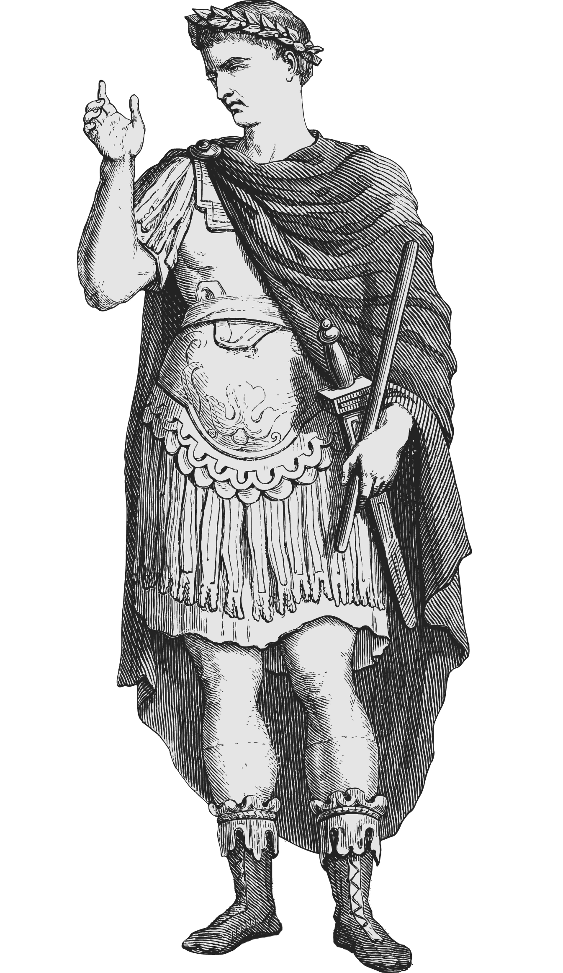
Checkpoint: Almost There!
By the end of class, you will be able to:
Any Questions?
Articulate the goals of cryptography.
Discuss modern encryption standard, particularly AES.
Differentiate between substitution and transposition ciphers.
Explain how textual data can be represented in binary, octal, and hex.
Determine the output of the XOR operation given two input bitstreams.
Compare and contrast symmetric and asymmetric cryptography
Use OpenSSL to encrypt data with a symmetric key.

